Slide 1
The Open Web
What is it and how can we fight for it?
Kade Morton
Mozilla Regional Coordinator
kademorton@protonmail.com / @cypath

Slide 2
Agenda
What is the Open Web (explained through some context)
What are the threats to the Open Web
How can we fight for it?

Slide 3

If Aaron Swartz is your jam

Slide 4
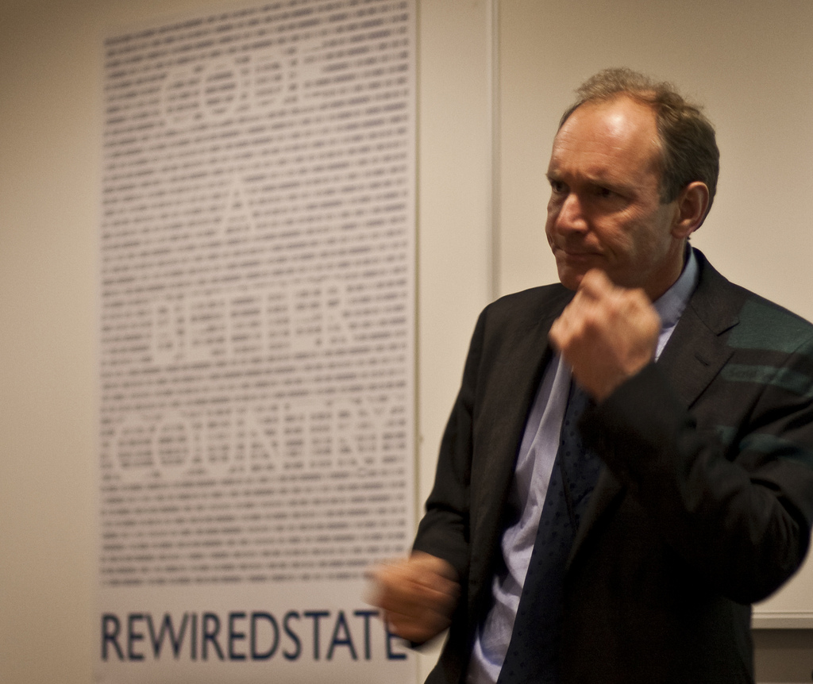
Pop quiz, who is this dude?

Slide 5

The Splinternet
Further reading, the Economist has a great article on the splinternet http://www.economist.com/news/international/21709531-left-unchecked-growing-maze-barriers-internet-will-damage-economies-and

Slide 6
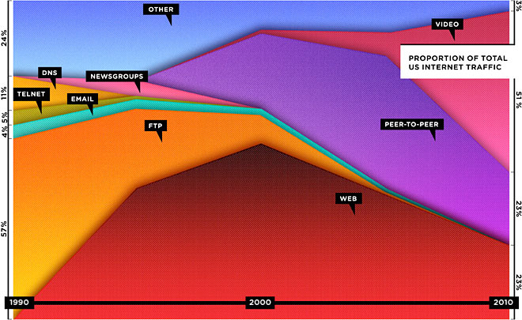
The Open Web

Slide 7
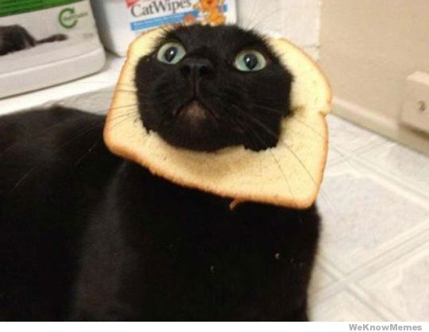
Typical Internet usage

Slide 8

Possible Internet usage

Slide 9

The next threat

Slide 10
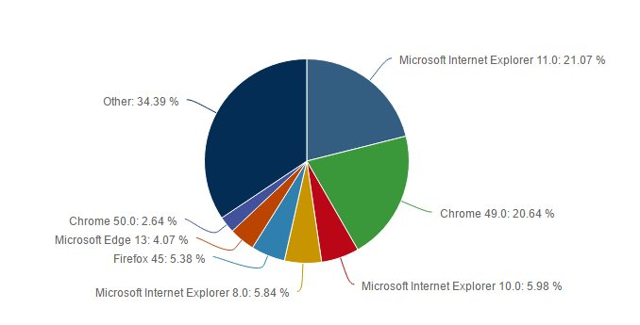
Browser market fragmented
Stats as of 2016

Slide 11

Who are these guys anyway?

Slide 12

...and the project was called...
Mozilla is a portmanteau of Mosaic and Godzilla, and was the code name for Netscape Navigator during development

Slide 13
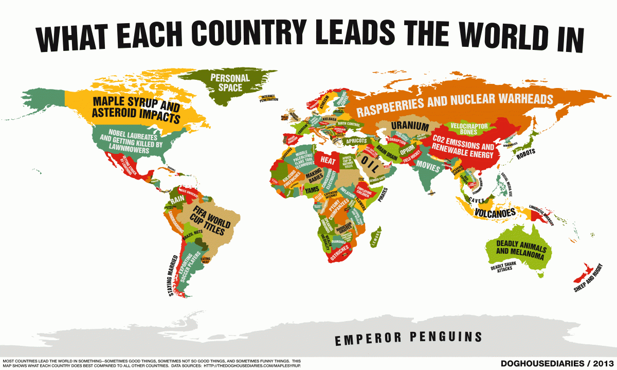
Threat 1. Nation States

Slide 14

Threat 2. Trust, or lack thereof
Kudos to anyone who gets the reference.

Slide 15

Threat 3. Commercial pressures

Slide 16

Threat 4. Too much information

Slide 17
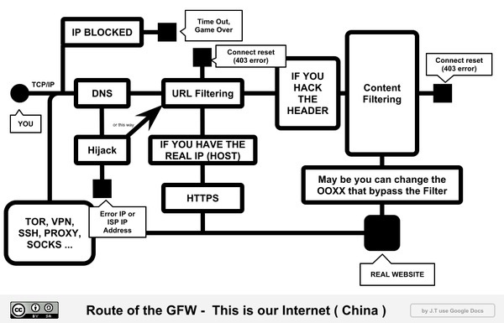
Thought I was going to talk about Prism, didn’t you?

Slide 18


Slide 19
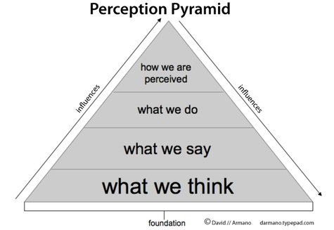
If I control your perception, I control YOU

Slide 20
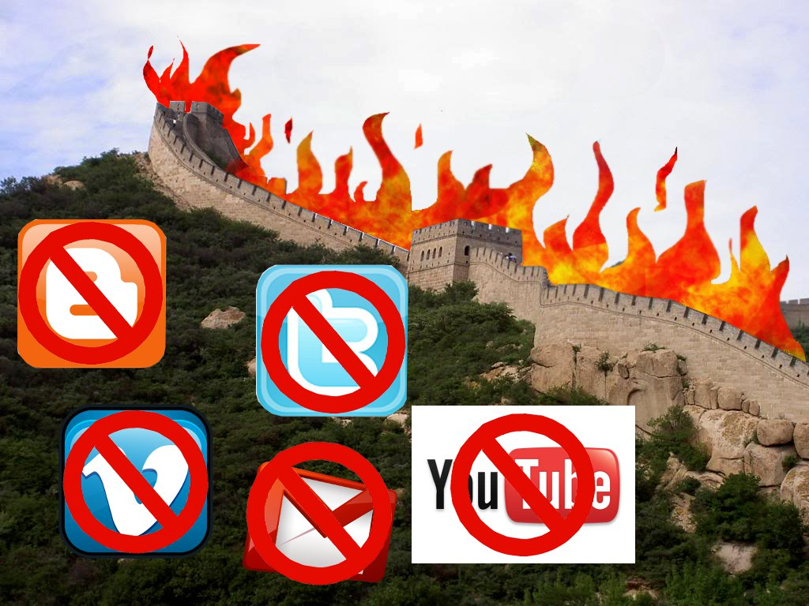
China’s Firewalled Garden

Slide 21
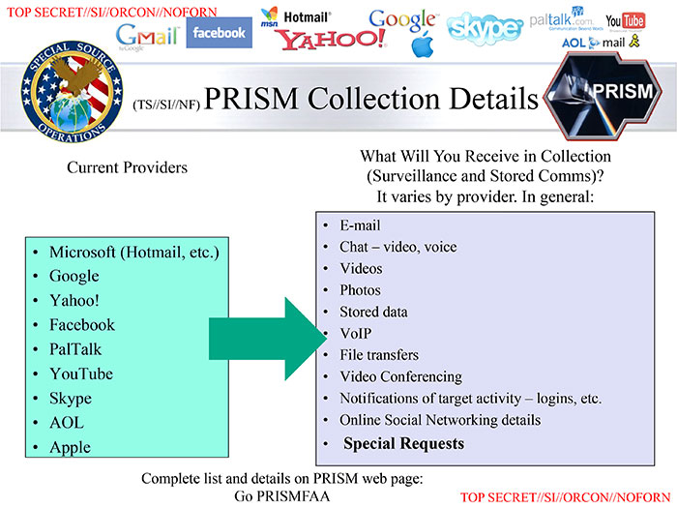
Now I’m going to mention Prism...

Slide 22
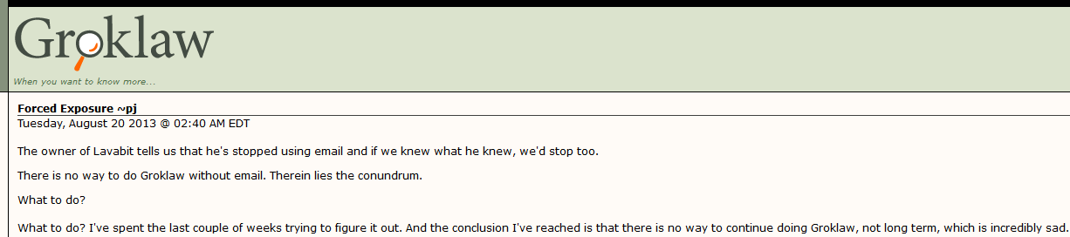
People do just opt out of the Internet
In 2013 Pamela Jones shut down Groklaw, a popular law review website, and left email completely, over the Lavabit revelations

Slide 23

Competing standards

Slide 24
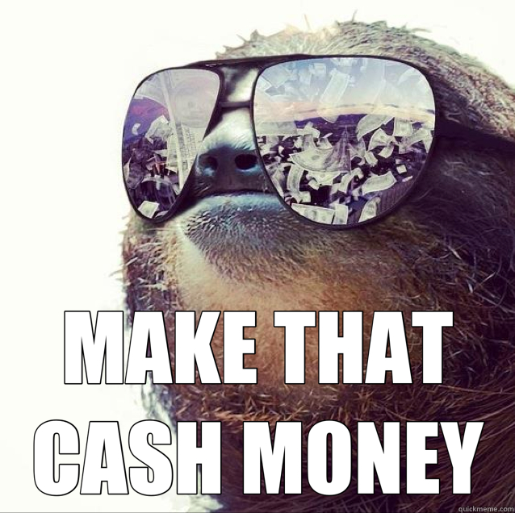
Splinternets are lucrative...

Slide 25

...but imagine you saw this every day, every site you visited

Slide 26
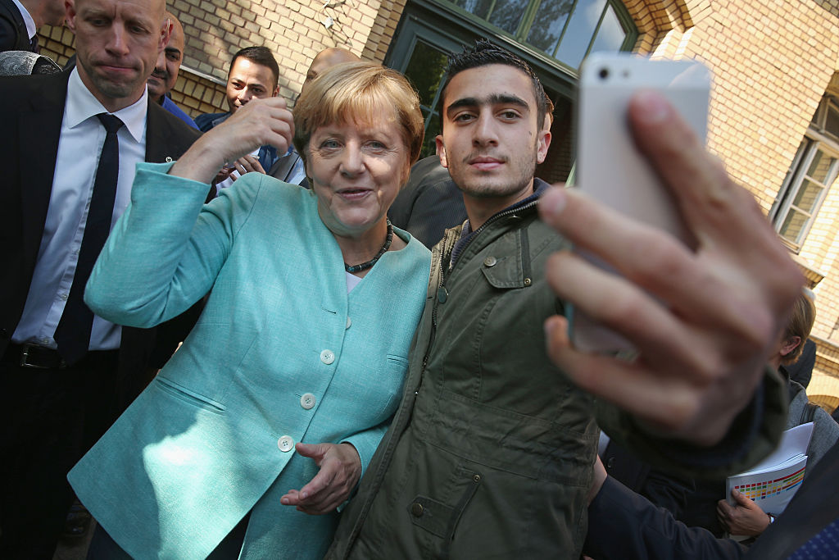
Fake news or alternative facts?
Anas Modamani was a Syrian refugee who took a selfie with the German Chancellor before the image was used to claim the Chancellor posed with one of the Brussels bombers, Najim Laachraoui

Slide 27

For profit companies choosing what we see
Does that sound like a good idea to you?

Slide 28
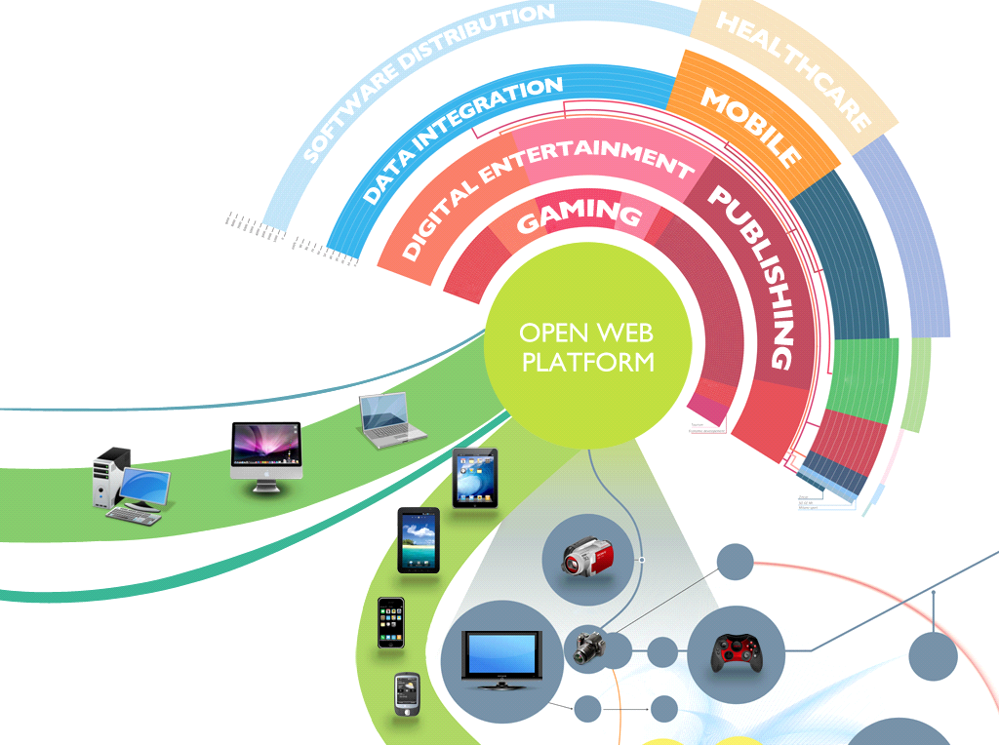
In summary...

Slide 29

Free Libre Open Source Software

Slide 31
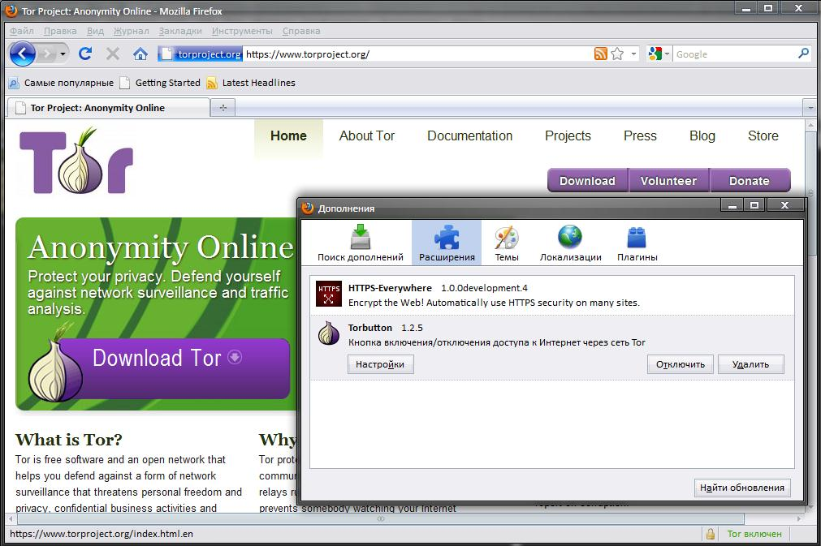

Slide 32
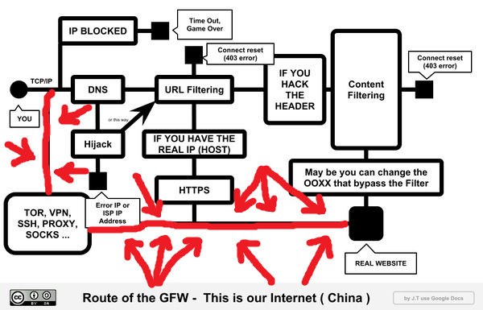

Slide 33


Slide 34
https://youtu.be/Xm5i5kbIXzc

Slide 35
Any questions you don’t want to ask in front of the group
kademorton@protonmail.com
@cypath

